Slide 1
Fertility in teenagers with varicoceles
David Keene

Slide 2
Journey
Adult experience
Sperm tests in adolescents
Asymmetrical testes
Symmetrical testes

Slide 3
Adults
Meta-analyses (Evers Cochrane Rev 2012)

Slide 4
Adults
Meta-analyses (Evers Cochrane Rev 2012)
Weakly positive effect
Number needed to treat 17 patients for 1 extra pregnancy

Slide 5
Similarities to bilat UDT
Christman

Slide 6
Optimum treatment window
 | Theories | Window
UDT | Transformation of gonocytes into Ad spermatogonia | 9-12 months
Varicoceles | 1. Hyperthermia 2. Abnormal blood flow 3. Hypoxia and adrenal reflux 4. Endocrine imbalance | End of puberty

Slide 7
Manchester experience
360 adolescents (10-17y)
151 have had surgery
135 sperm tests <16
66 sperm tests >17

Slide 8
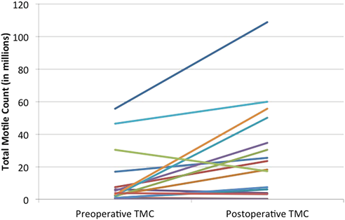
Avoid TMC in teenagers
Chu 2017 JPU
Total motile count = semen volume x concentration x forward motility
Positively correlated with age therefore must not use<18 yrs

Slide 9
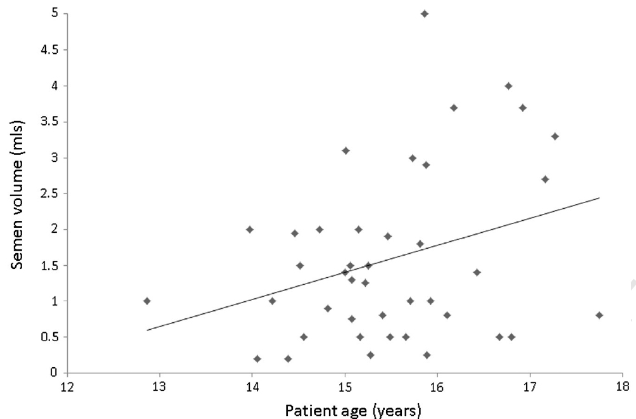
Sperm volume increases

Slide 10
Individual sperm parameters
Keene JPS 2016

Slide 11
Paternity studies

Slide 12
Paternity metanalysis

Slide 13
Testicular asymmetry
Asymmetry impairs sperm concentration & forward motility (Keene 2012)
80% experience catch up growth of testis

Slide 14
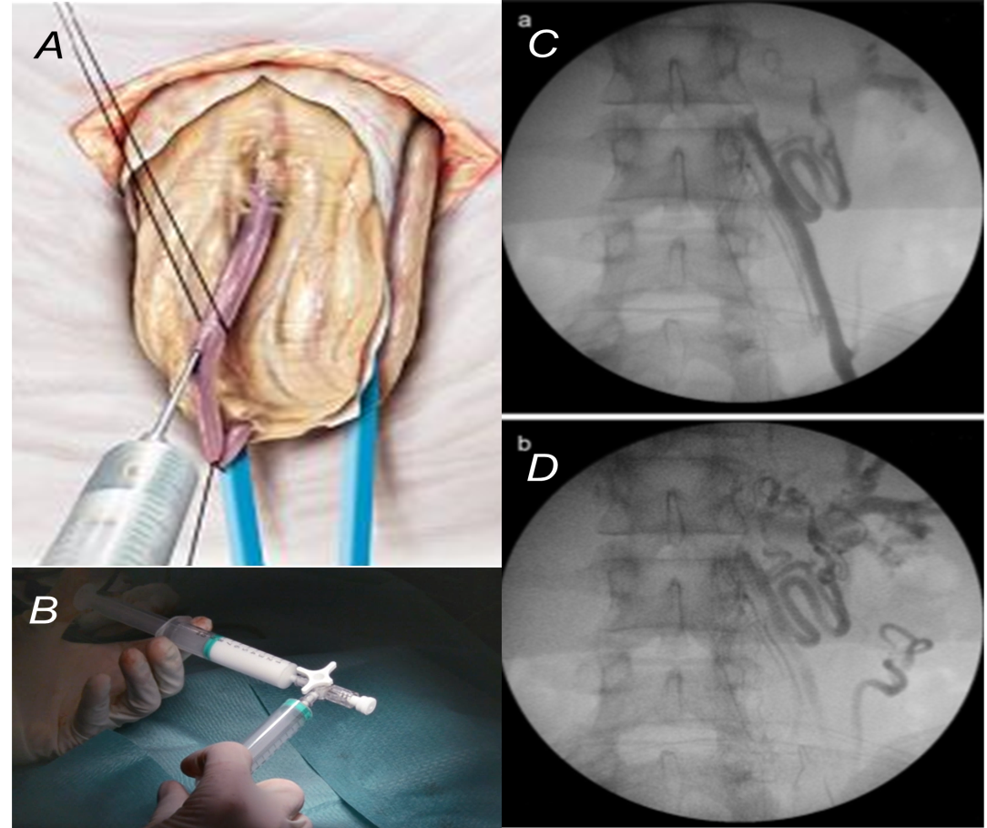
Antegrade foam sclerotherapy
Modified Tauber technique
2mls aethoxysklerol + 8mls air => FOAM
0% hydroceles
98% success

Slide 15
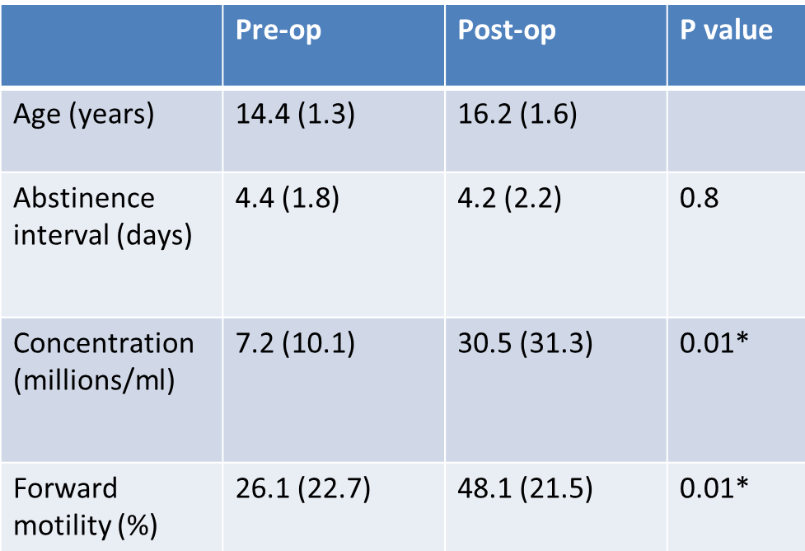
Catch up growth
80% restore size
Sperm quality improves

Slide 16
Paired sperm analysis
POST-OP SPERM
4 patients completely normal sperm parameters
36% low at 18yrs (Zampieri & Cervellione 2008)
PRE-OP SPERM
all 9 patients had abnormal sperm parameters
POST-OP SPERM
5 patients improved sperm concentration +/- forward motility

Slide 17
Symmetrical testes
Don’t meet criteria for surgery
20% subfertile at 18yrs (Zampieri & Cervellione 2008)
What happens over time?
Manchester RCT early surgery vs conservative management

Slide 18
Manchester RCT
Interim results: (78 patients)
No difference in sperm conc. between groups

Slide 19
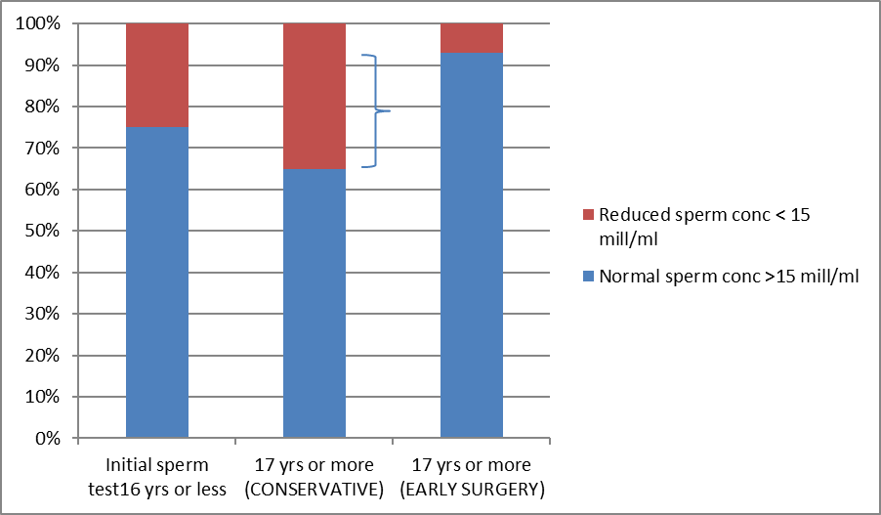
Manchester RCT Subgroups
75% start normal
10% get worse (CONS)
25% start + finish poor
may benefit from early surgery

Slide 20
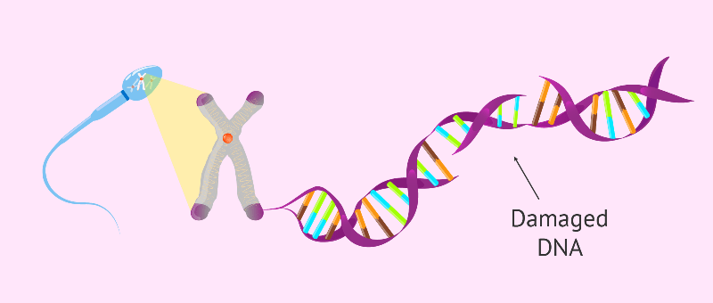
Areas for research
DNA fragmentation metanalysis
Birowo et al. 2020

Slide 21
Summary
Teenagers different from adults
Testicular size signpost not goal
Sperm tests key but avoid TMC
Reversible growth & fertility
Future –DNA fragmentation

